Slide 1
The Beginning of Korean History
Korea’s Cultural History KF-HYU Global e-School Course Professor Michelle Kwon
October 18, 2012

Slide 2
Artifacts from Prehistoric Korea
100,000 BC:
Stone Hatchet
Yeokpo Child bone found near Pyeongyang
50,000 BC: Seungrisan Man
4,000 BC:
Comb-patterned pottery
Grinding stone board and grinding stone

Slide 3
Origins of Man on the Korean Peninsula
4,000 BC: People began settling down and farming from the Paleolithic Period.
Neolithic farming tools (photo link)
Cultivated land near rivers and made fires on hilltops.
Used stone plows to till the soil and stone sickles to reap their harvests

Slide 4
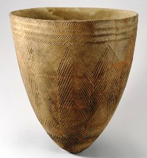
Comb-patterned Clay Pots
Commonly used between 40,000 and 10,000 BC when people lived near rivers and streams and lived off hunting and fishing.

Slide 5
Gojoseon: the First Kingdom
2333 BC: Gojoseon founded by Dangun, which was recorded in the Samgukyusa written by Il-yeon in the 13th century.
Dangun is a symbol of Korean independence
October 3rd is National Foundation Day in South Korea

Slide 6
Gojoseon’s Development
Due to Han China’s encroachment east, Gojoseon grew to assimilate states near its border and developed into a confederate kingdom that ruled neighboring small states since 4,000 BC
Accepted and embraced the advanced civilization of the Han race, including Chinese letters.
2,000 BC, Gojoseon had built its own economy and enhanced its military power with iron-based tools and weapons

Slide 7
Conflict with Han China
109 BC: Han China sends 50,000 of Wu Ti’s troops to Gojoseon
Even though Gojoseon stood its ground for a year, the capital city finally fell in 108 BC
Han China set up command posts in Gojoseon to rule from remote

Slide 8
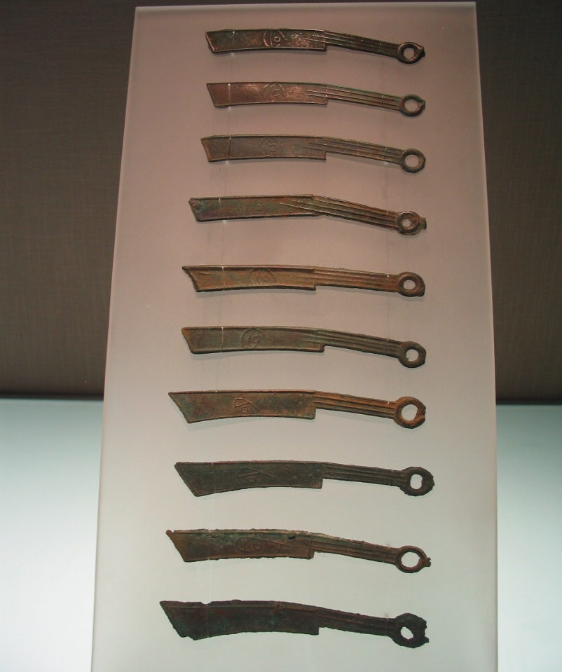
Myeongdojeon
Was sword-shaped iron currency that was used in Yan and Qi China in 3000 BC
Found all over the region that belonged to Gojoseon, which implies that Gojoseon was active in trade with Yan and Qi China

Slide 9
Iron Changes the World
In the Gojoseon region, Myeongdojeon was often discovered with iron tools, including agricultural/mechanical tools and weapons, such as spears and swords.
Replacing wood/stone tools and making more efficient weapons, iron tools increased agricultural productivity and military tactics.

Slide 10
Other States: Jin, Bueyo
2nd century BC: Gojoseon expanded its territories by uniting the political forces, and blocking others from trading with China directly
Jin: founded in the south of Gojoseon around 10th century BC
Bueyo: at the basin of the Songhua River, based its economy on farming and animal breeding

Slide 11
Dolmen
Believed to have been built between the 15th and 10th centuries BC
North: dolmens resemble large tables
Central/southern areas: dolmens look like square0shaped game boards
Purpose of dolmens?
Bury people of significant importance?
Stone tombs/monuments for religious services?

Slide 12
Korean Chuseok
Harvest festival; ritual of thanksgiving
Considered to be the most important holiday in Korea: August 15th (lunar calendar)
A time family gatherings

Slide 13
Beginning of the Three Kingdoms Period
Goguryeo, Baekje, and Shilla
All emerged in the 1st century BC
Grew into centralized kingdoms between the 4th and 5th centuries
Goguryeo: fought off invading China
Baekje: traded with Japan
Shilla: expanded its power after the 6th century BC and unified the three kingdoms

Slide 14
Buyeo
After Gojoseon’s collapse, Buyeo became the No. 1 power among the political forces in the north, advanced farming, and developed into a powerful state.

Slide 15
Goguryeo
Originated out of Buyeo and established by Jumong in 37 BC, Goguryeo remained a threat to Buyeo.
Assimilated minor tribes around it in order to take control of prairies near Buyeo and Han China, despite a good relationship between China and Buyeo

Slide 16
Baekje
18 BC: Baekje, which was established earlier by those from Goguryeo, emerged near today’s Seoul as a confederated kingdom which incorporated various walled-town states of Mahan.
During the 3rd century BC, it expanded its borders and grew large enough to occupy the entire Hangang region.

Slide 17
Shilla
The Shilla Kingdom, which would literally last for a millenium (57 BC – 935 AD)m was formed in Gyeongju in the southeast side of the Korean Peninsula.
In this area, many states called the Jinhan Alliance were established and prospered around the BC 2nd and 1st AD centuries.
The Saro state, which emerged in Gyeongju, developed into a leading force by assimilating surrounding political powers.

Slide 18
Gaya
On the west side of the Nakdong River, which passes through the southeastern part of the Korean Peninsula, there was the Gaya Alliance of six allied states led by the central state of Guya.
Farming and producing substantial amounts of iron, the state of Guya became the trade center with the NW region of Korea, as well as Japan.

Slide 19
Fall of Buyeo and Gaya
Buyeo was eventually destroyed by the attacks from nomadic tribes from the west
4th century, its capital was turned to ruins with more than 50,000 people captured
Later, the royal lineage of Buyeo resurrected, but soon merged with Goguryeo
At the end of the 4th century and early 5th century, Gaya suffered a defeat by the allied forces of Goguryeo and Shilla and could barely maintain its state.

Slide 20
Goguryeo’s Rise
In 311, Goguryeo expanded its territory all the way south to the Amnokgang basins, and seized power throughout the NW region formerly the realm of the late Gojoseon.

Slide 21
Baekje and Goguryeo Conflict
In the middle of the 4th century, Baekje and Gogureyo had frequent battles
In 369, the Baekje army defeated Goguryeo troops led by a king
In 371, Baekje even killed the king of Gogureyo at the battle of Pyeongyangseong
Baekje’s reach SW, threatened several states inside Gaya, located between Shilla and Baekje

Slide 22
Rise of Goguryeo
By adopting the political ruling system of China and implementing educational institutes to train political administrators, Goguryeo reinforced its centralized ruling power.
When Goguryeo sent 50,000 troops to the south, Baekje lost the northern area of the Hangang, and the king of Shilla pledged its loyalty to Goguryeo.
King Jangsuwang moved the capital to Pyeongyang and engulfed more populated areas and fertile lands of the south.
Goguryeo’s army even attacked and occupied Baekje’s capital city of Hanseong, the Hanam Wiryeseong fortress, penetrating deep inside the inlands of the Hangang area.

Slide 23
Shaken Baekje and Shilla
After the capital fell, the king was executed by Gogureyo, Baekje moved its capital to Ungjin (today’s Gonju), maintaining a wartime ruling system for survival.
Shilla was also threatened by Goguryeo’s growing power.

Slide 24
Allied Baekje and Shilla
In response to Goguryeo’s southbound advance, Baekje and Shilla formed an alliance to protect themselves from Goguryeo by arranging a marriage between the two royal families.

Slide 25
Rise of Shilla
Beginning in the 4th century, Shilla began to centralize the kings’ leadership and evade Goguryeo’s intrusions.
In the early 6th century, Shilla was able to unite all the areas of the Nakdong River region and assimilate Ulleungdo Island of the East Sea into its territory.
During the reign of King Jinheungwang (540-576), Shilla annexed Gaya, attacked Goguryeo, and fought with Baekje, as well as securing an independent diplomatic relationship with China.

Slide 26
Sui China and Shilla in the 7th Century
After unifying China, the Sui Dynasty’s desire to expand outside of China helped Shilla put military pressure on Goguryeo.
Goguryeo allied with Dolgweol, as well as Baekje who was backed by Japan.

Slide 27
Goguryeo Wins Against Sui
Refusing to submit to the Sui’s order, Goguryeo mobilized for battle.
In 598, the first Sui emperor Munje attacked Goguryeo by both land and sea, but was defeated.
In 612, the second Sui emperor Yange led an attack with 1.13 million troops against a 3.5 million population of Goguryeo, but was defeated then and again in 614.

Slide 28
Tang Dynasty and Goguryeo
In 645, Goguryeo was attacked by Tang troops led by Taizong, but once again, Tang’s troops were forced to withdraw.
Consecutive battles left irreparable damage on Gogureyo, and as a result, its power weakened substantially.

Slide 29
Korean Food
What do you know about Korean food?
Have you ever eaten kimchee?
What can you gather about Korean culture by the food Koreans eat?

